Slide 1
NGS: Downstream Analysis & Processing

Slide 2
The Plan…
Downstream analysis
Downstream processing
Gene sets
Transcriptome studies
Cistrome / Epigenome studies
Function enrichment
GSEA, DAVID, IPA
STRING, Cytoscape
Genome coordinate sets
NGS alignment files (reads/tags)
ChIP-Seq peaks
BEDTools
Galaxy
UCSC Table browser

Slide 3
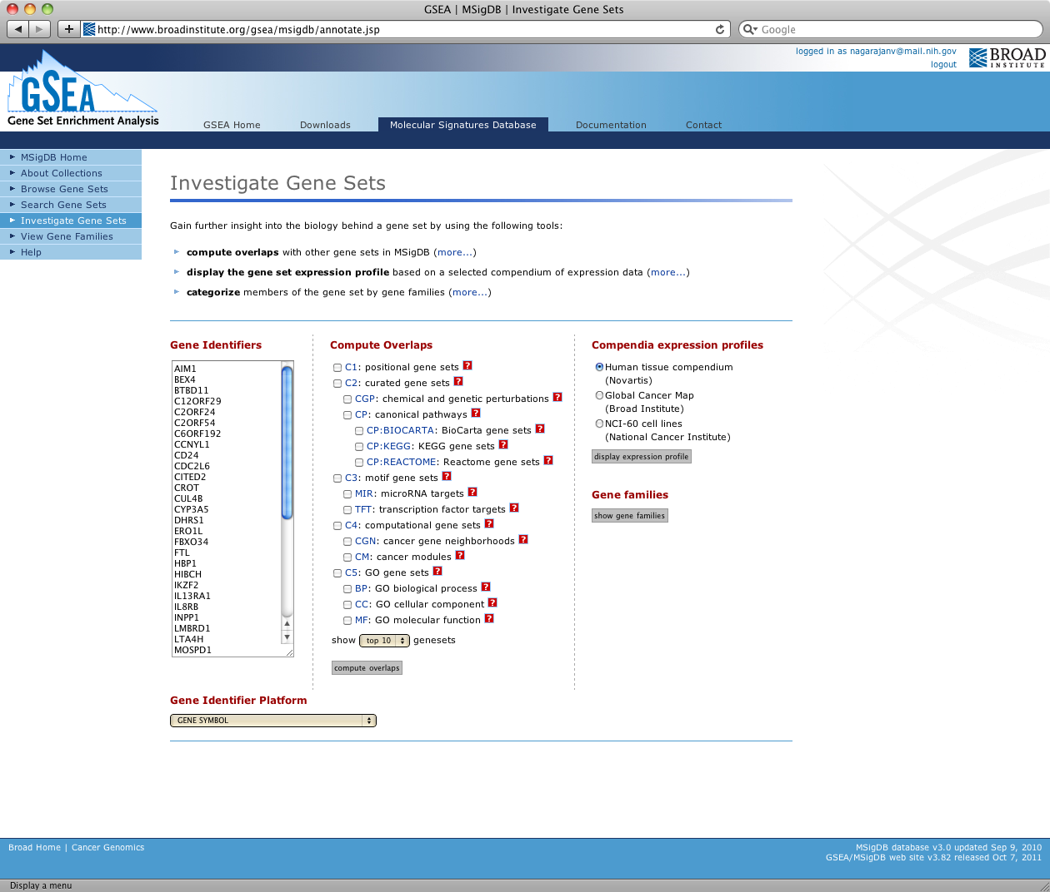
Gene Set Enrichment Analysis (GSEA) http://software.broadinstitute.org/gsea/index.jsp
Gene Set Enrichment Analysis (GSEA)
Broad Institute
“A computational method that determines whether an a priori defined set of genes shows statistically significant, concordant differences between two biological states”
Download the GSEA software and additional resources to analyze, annotate and interpret enrichment results.
Explore the Molecular Signatures Database (MSigDB), a collection of annotated gene sets for use with GSEA software.

Slide 4
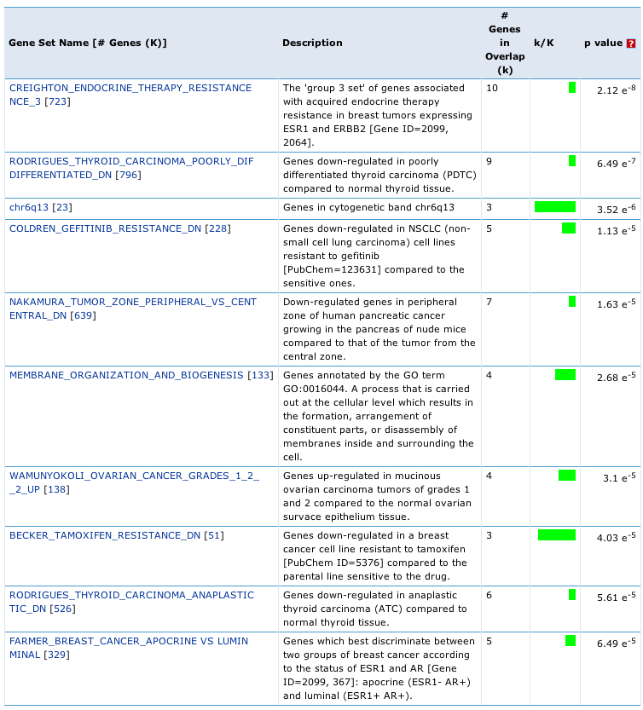
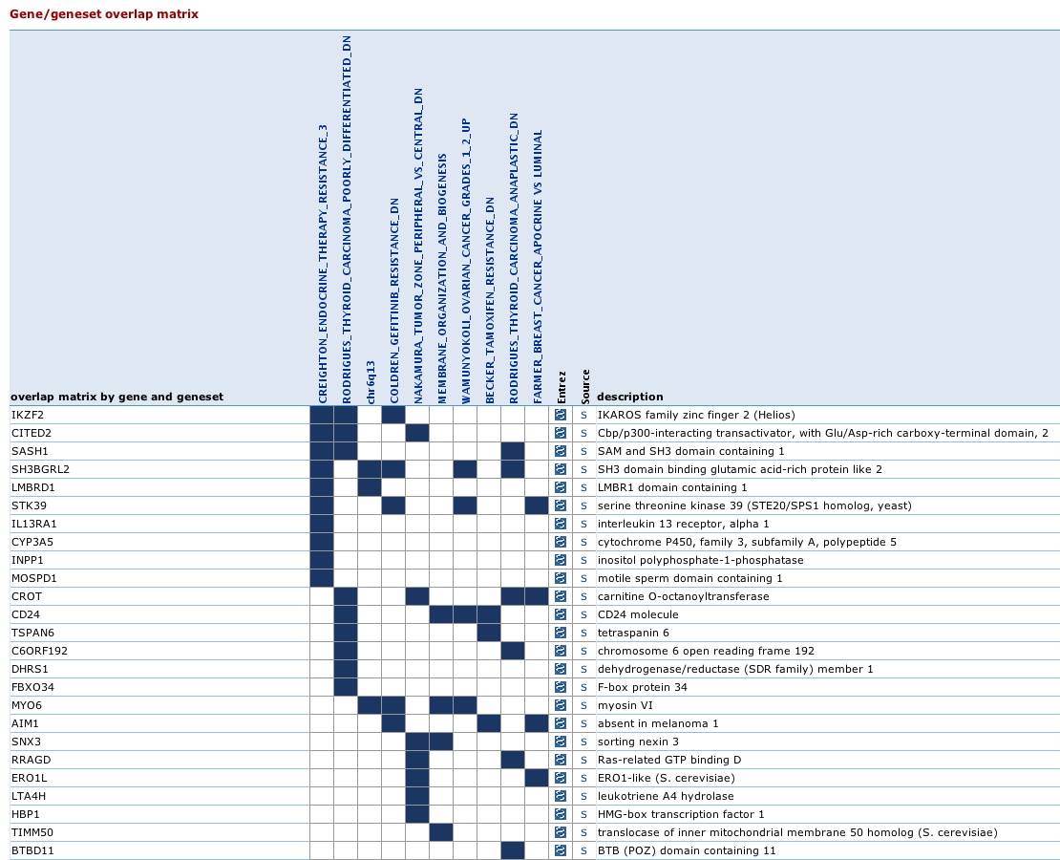
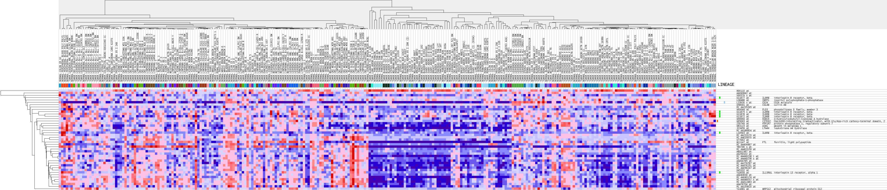
Gene Set Enrichment Analysis (GSEA) http://software.broadinstitute.org/gsea/index.jsp

Slide 5
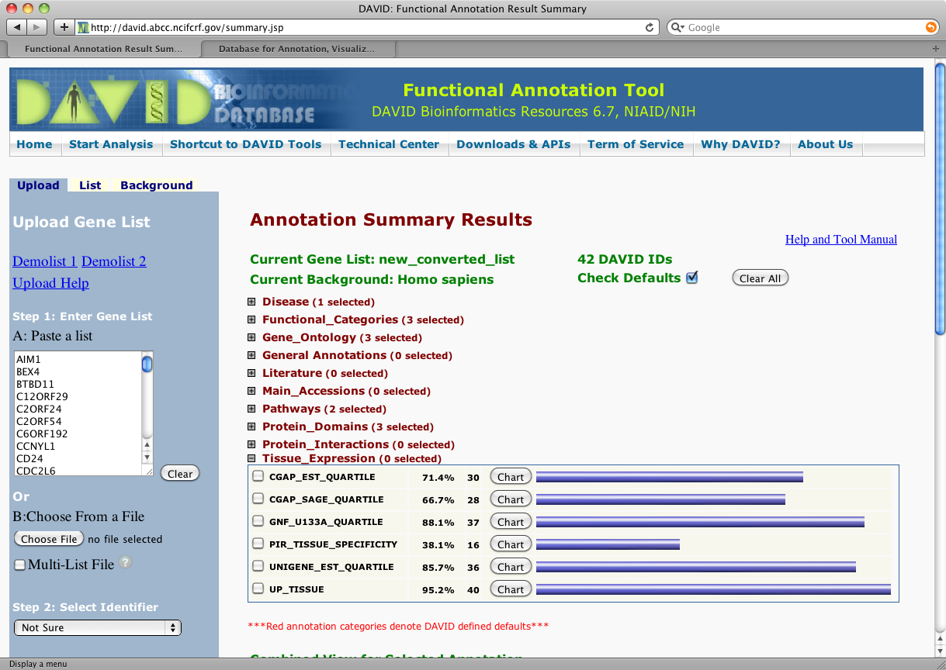
Database for Annotation, Visualization and Integrated Discovery (DAVID) https://david.ncifcrf.gov/
DAVID provides a comprehensive set of functional annotation tools for investigators to understand biological meaning behind large list of genes.
For any given gene list, DAVID tools are able to:
Identify enriched biological themes, particularly GO terms
Discover enriched functional-related gene groups
Cluster redundant annotation terms
Visualize genes on BioCarta & KEGG pathway maps
Display related many-genes-to-many-terms on 2-D view.
Search for other functionally related genes not in the list
Notes:
The Database for Annotation, Visualization andIntegrated Discovery (DAVID ) v6.8 comprises a full Knowledgebase update to the sixth version of our original web-accessible programs. DAVID now provides a comprehensive set of functional annotation tools for investigators to understand biological meaning behind large list of genes. For any given gene list, DAVID tools are able to: Identify enriched biological themes, particularly GO terms Discover enriched functional-related gene groups Cluster redundant annotation terms Visualize genes on BioCarta & KEGG pathway maps Display related many-genes-to-many-terms on 2-D view. Search for other functionally related genes not in the list List interacting proteins Explore gene names in batch Link gene-disease associations Highlight protein functional domains and motifs Redirect to related literatures Convert gene identifiers from one type to another. And more

Slide 6
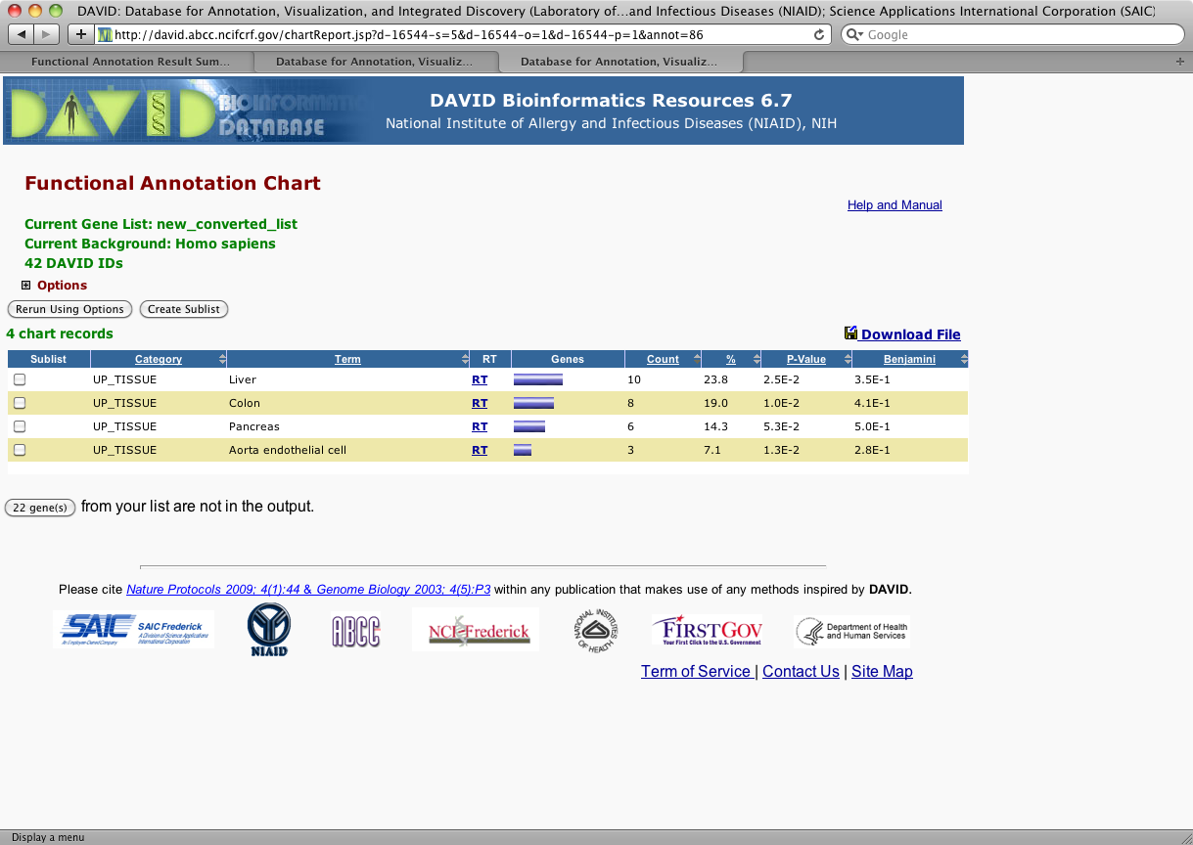
Database for Annotation, Visualization and Integrated Discovery (DAVID) https://david.ncifcrf.gov/
Cont.
List interacting proteins
Explore gene names in batch
Link gene-disease associations
Highlight protein functional domains and motifs
Redirect to related literatures
Convert gene identifiers from one type to another.

Slide 7
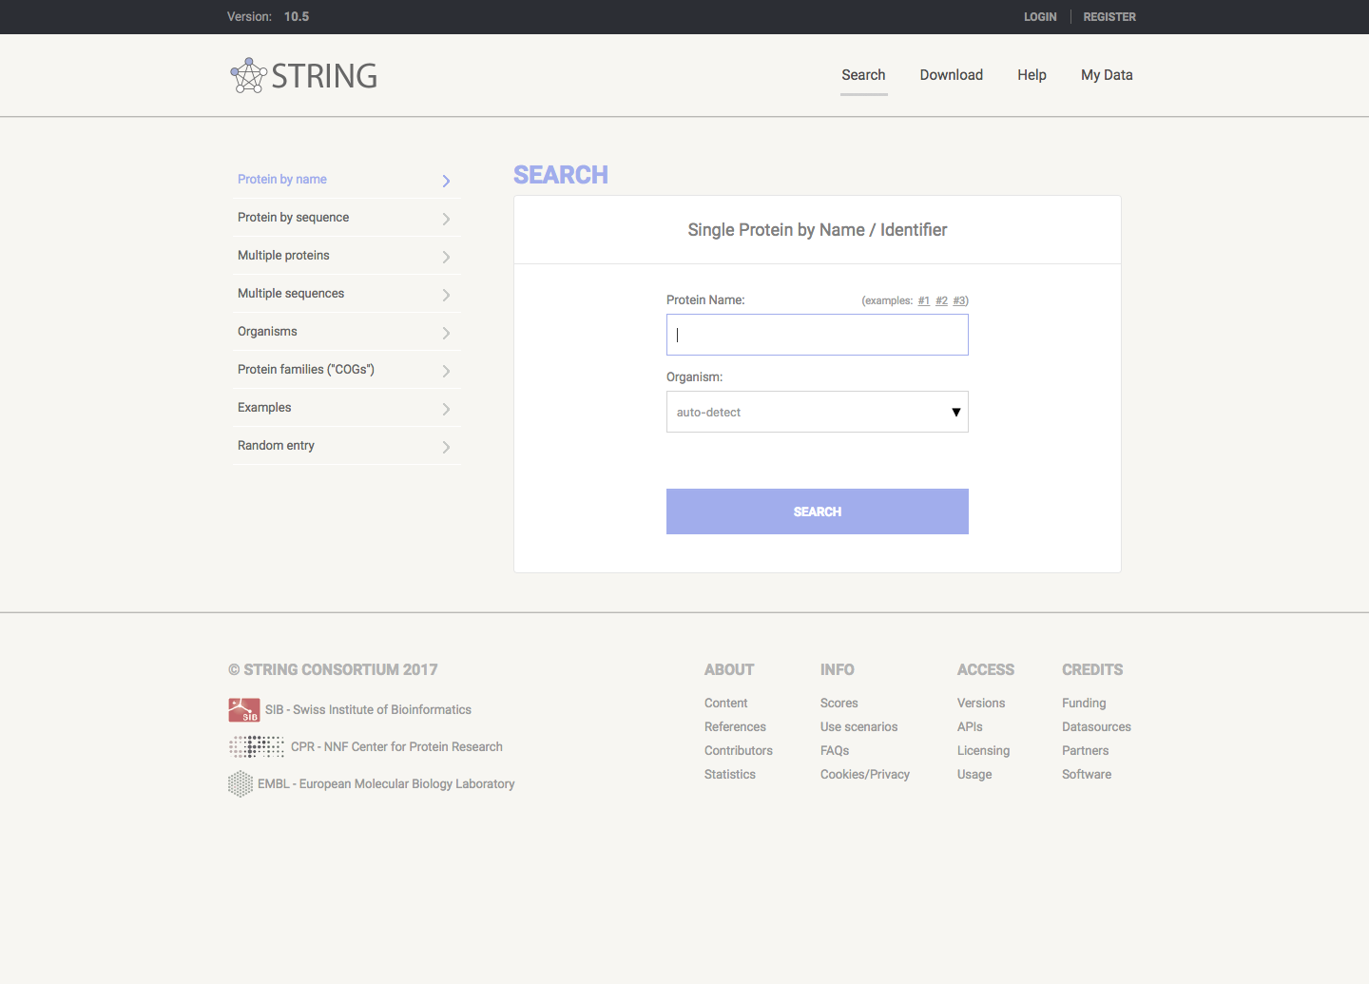
Search Tool for the Retrieval of Interacting Genes/Proteins (STRING) https://string-db.org
STRING (Search Tool for the Retrieval of Interacting Genes/Proteins) is a biological database and web resource of known and predicted protein–protein interactions.
Notes:
Protein-Protein Interaction Networks

Slide 8
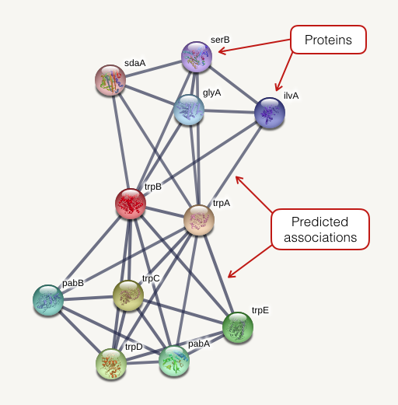
Search Tool for the Retrieval of Interacting Genes/Proteins (STRING) https://string-db.org
Notes:
Protein-Protein Interaction Networks

Slide 9
Cytoscape http://www.cytoscape.org/
Software
Cytoscape is an open source software platform for visualizing molecular interaction networks and biological pathways and integrating these networks with annotations, gene expression profiles and other state data.

Slide 10
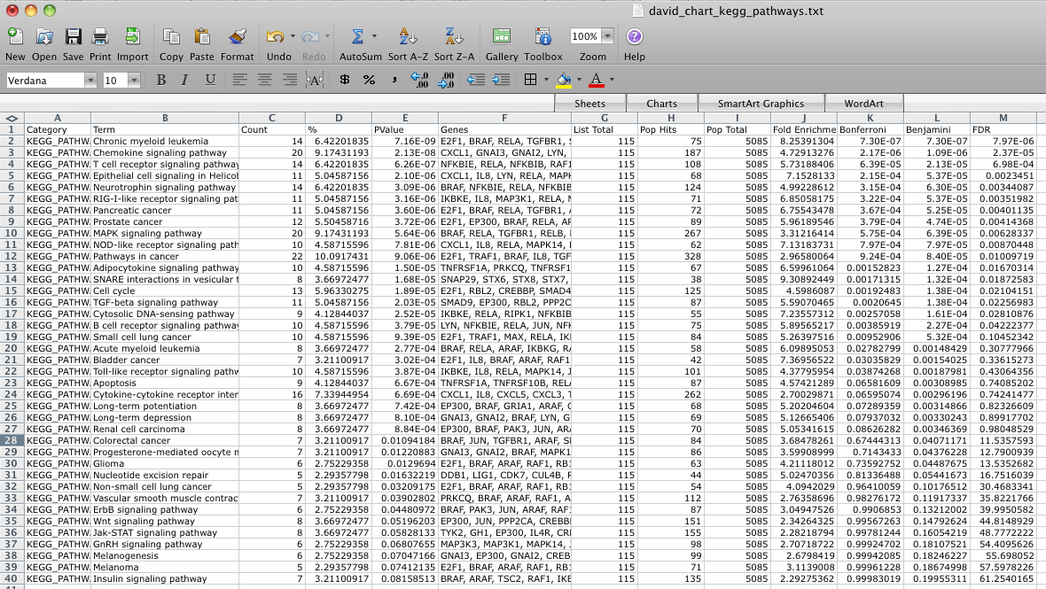
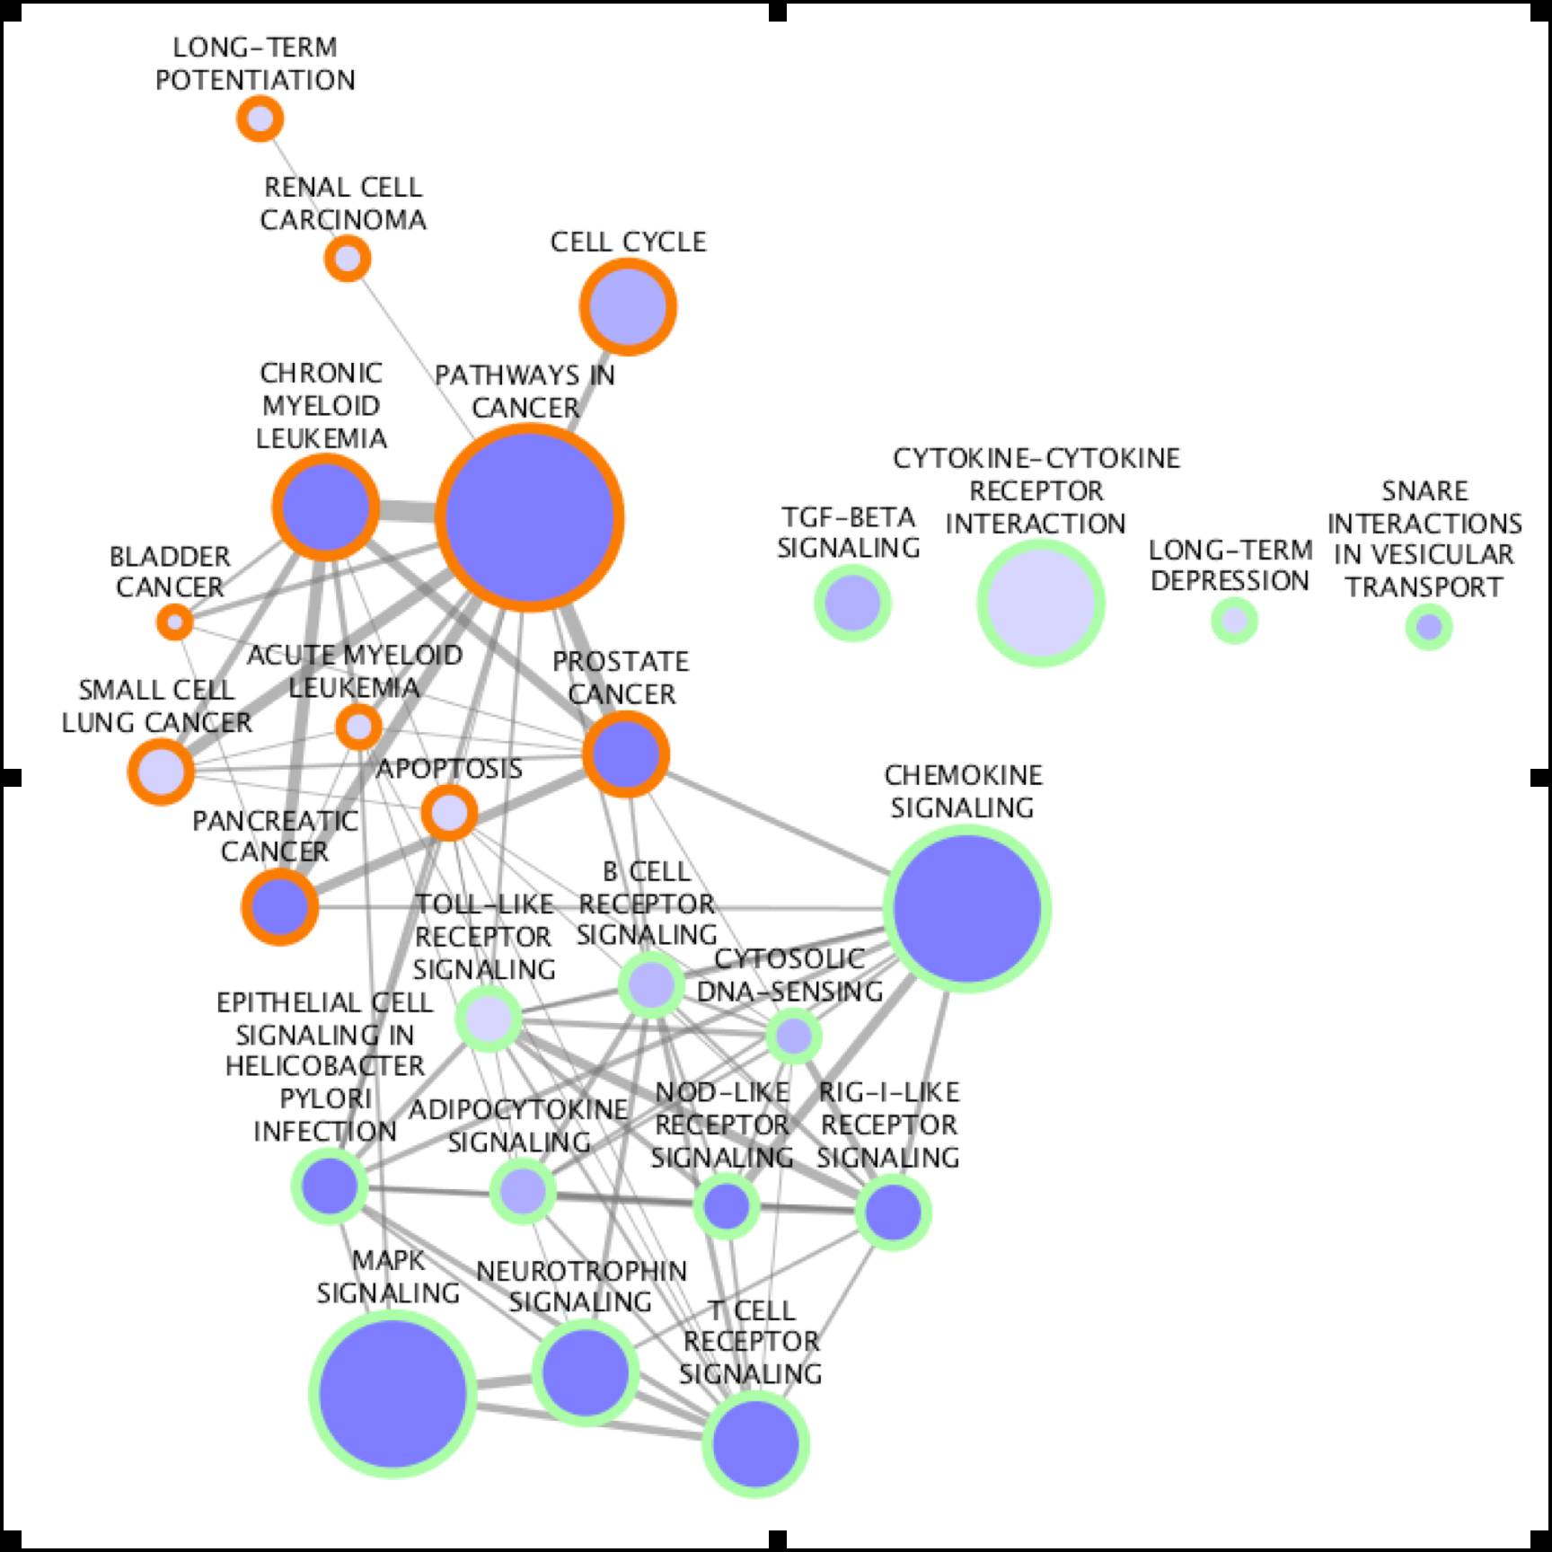
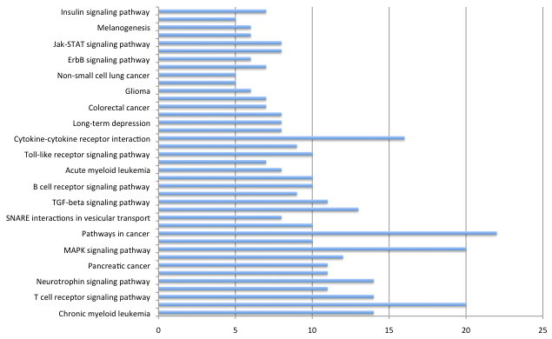
Cytoscape http://www.cytoscape.org/

Slide 11
BED-Tools http://bedtools.readthedocs.io/en/latest/
Command line
Open source
A variety of input formats (BED, BEDPE, SAM/BAM, GFF, VCF)
Things we could do…
Intersect, Union
Merge
Coverage
Subtract
Convert
Closest
Shuffle
Group, Sort

Slide 12
Commercial Tools

Slide 13
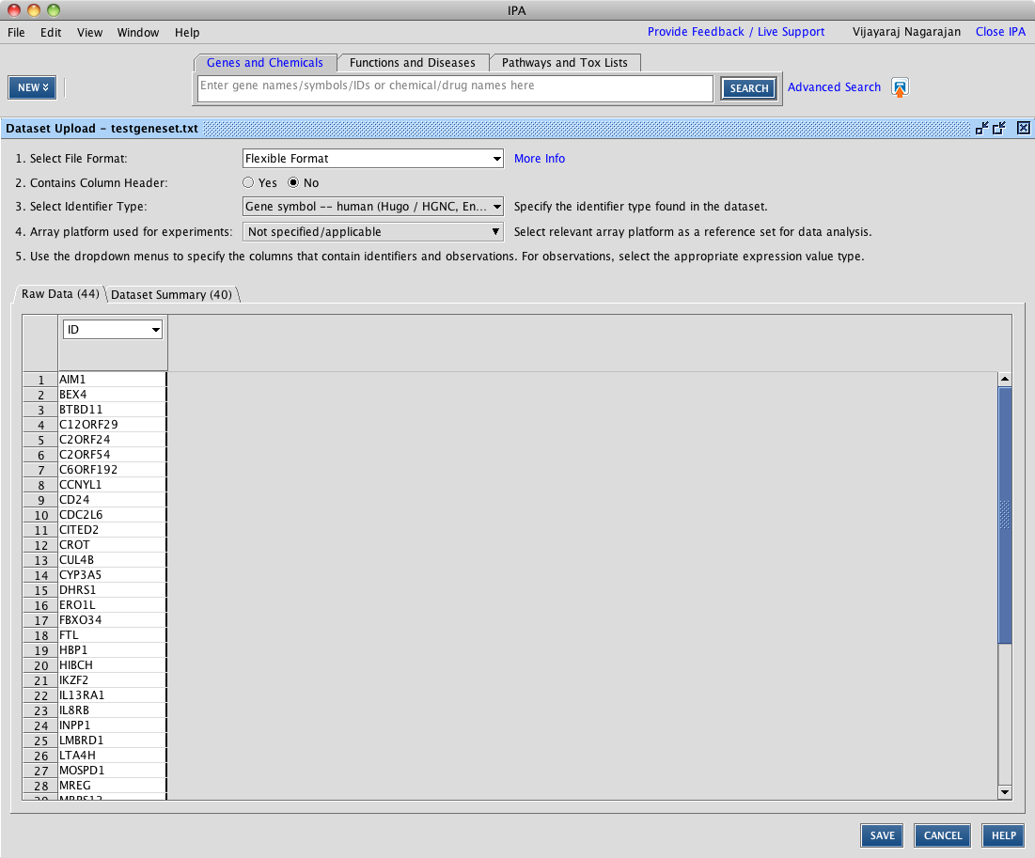
Ingenuity Pathway Analysis (IPA) https://www.qiagenbioinformatics.com/products/ingenuity-pathway-analysis/
Ingenuity Pathway Analysis is a powerful analysis and search tool that uncovers the significance of ‘omics data and identifies new targets or candidate biomarkers within the context of biological systems.
Canonical Pathway
Molecule Activity Predictor (MAP) Upstream Regulator Analysis
Mechanistic Networks
Downstream Effects Analysis
Regulator Effects
Network Analysis
…
Notes:
Ingenuity® Pathway Analysis (IPA®) is a powerful analysis and search tool that uncovers the significance of ‘omics data and identifies new targets or candidate biomarkers within the context of biological systems. IPA has broadly been adopted by the life science research community and is cited in thousands of articles for the analysis, integration, and interpretation of data derived from ‘omics experiments, such as RNA-seq, small RNA-seq, microarrays including miRNA and SNP, metabolomics, proteomics, and small scale experiments.
With it’s many features, IPA allows you to quickly understand and visualize your data.

Slide 14
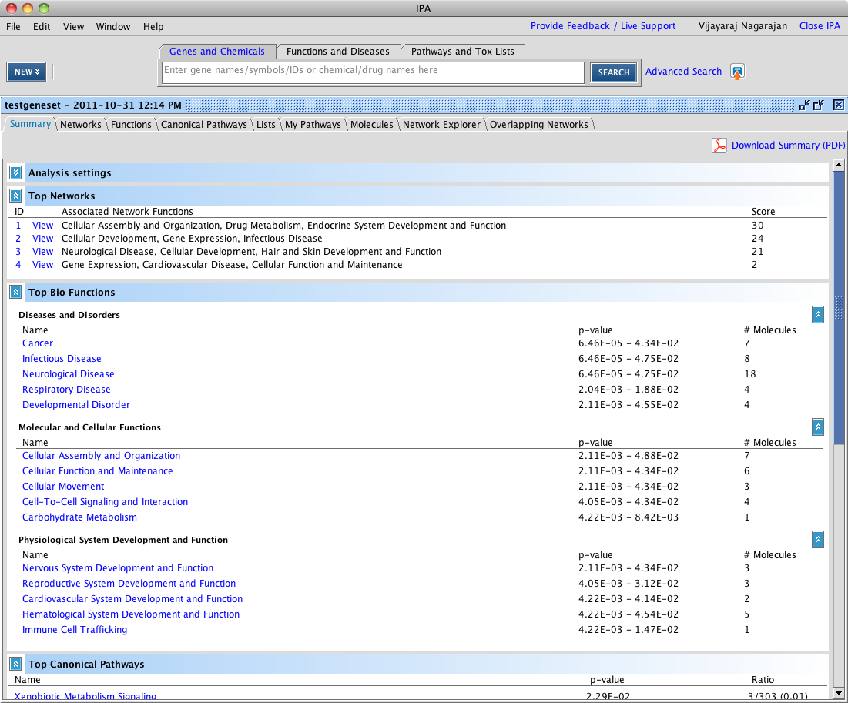
Ingenuity Pathway Analysis (IPA) https://www.qiagenbioinformatics.com/products/ingenuity-pathway-analysis/
Cont…
Comparison Analysis
MicroRNA Target Filter
Isoform View
Disease View
Tox Lists and Tox Functions
Gene and ChemView
Interactive Disease and Functions Nodes
Biomarker Filter
Path Designer

